Slide 1
Forensic Accountants
Paul Bustos, CFE, CRMA
Manager, Forensic & Litigation Services
Tele: 972-448-9251
E-mail: Paul.Bustos@Weaver.com

Slide 2
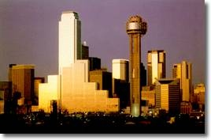



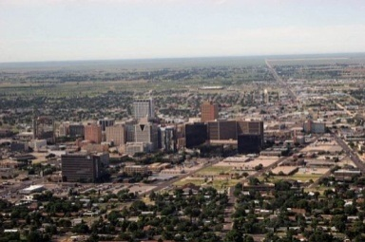
About Weaver
Largest independent firm in the Southwest with seven offices across all major Texas markets
Nationally ranked as a top 100 firm – No. 41 by Accounting Today and No. 38 by INSIDE Public Accounting
FY 2013 revenues of approximately $83.4 million
More than 60 years of experience
Approximately 450 employees, including 61 partners
Global reach through the Baker Tilly International network
DFW
Houston
Austin
San Antonio
Midland / Odessa

Slide 3

Outline
Fraud
Forensic Accounting
Local Cases in the News

Slide 4
Fraud

Slide 5
Fraud Definition
A generic term, embracing all multifarious means which human ingenuity can devise and which are resorted to by individual(s) to get advantage over another by
false suggestions or suppression of truth, and includes surprise, trick, cunning, and any unfair way by which another is cheated

Slide 6

Elements of Fraud
Misrepresentation
Intent to mislead
Reliance
Detriment

Slide 7
Primary Categories of Fraud
Asset Misappropriation | Corruption | Financial Statement Fraud
Theft or misuse of tangible and intangible assets | Utilizing influence in business transactions to obtain a personal benefit | Misstatement or omission of material information in financial statements
Most Common | Less Frequent | Most Rare

Slide 8
The Fraud Triangle
Opportunity
The only factor completely controlled/prevented by an organization
Must gain access to assets/records
Rationalization
  Ability to follow through and commit the fraud
  Perpetrator has to make it “okay” internally to perform the fraudulent act
OPPORTUNTY
RATIONALIZATION
CONCEALMENT
INCENTIVE/PRESSURE
INTENT/MOTIVE
Incentive/Pressure
The more incentive, the easier it is to justify
Financial or personal problems, financial
pressure, mental instability

Slide 9
Forensic Accounting

Slide 10
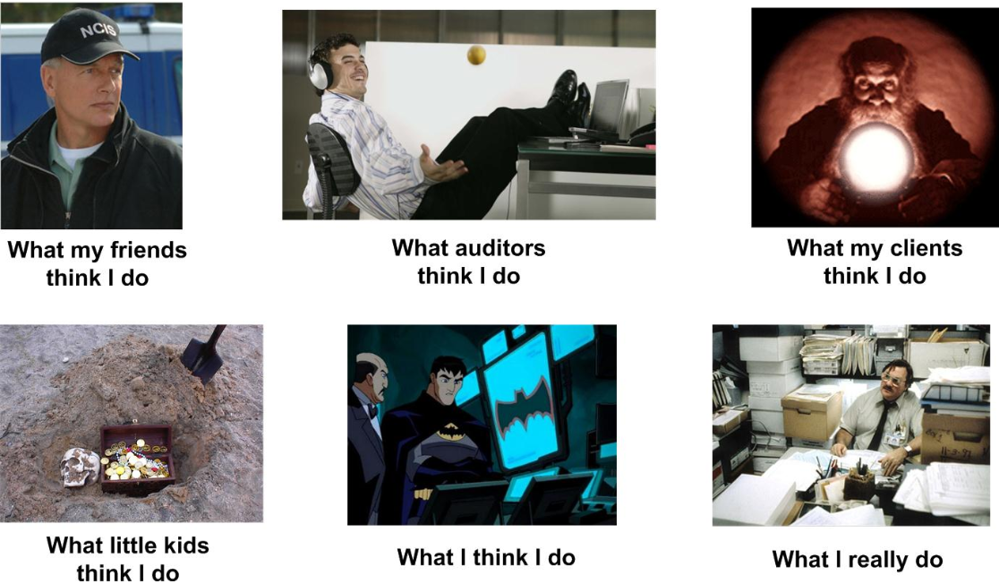
Forensic Accountant

Slide 11
Accountancy
Accountancy is the process of communicating financial information about a business entity to users such as shareholders and managers.
Elliot, Barry & Elliot, Jamie: Financial accounting and reporting, Prentice Hall, London 2004, ISBN 0-273-70364-1, p. 3,

Slide 12
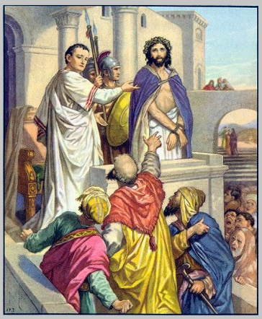
Forensics
Origin:
1650–60; < Latin forēns ( is ) of, belonging to the forum, public (see forum, -ensis) + ic

Slide 13
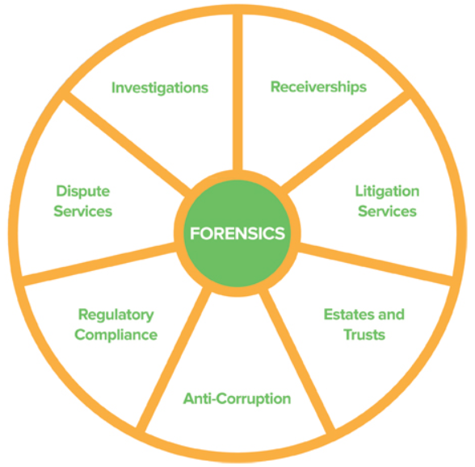
Types of Services
Litigation and dispute support services:
Helping counsel evaluate financial claims or defenses
Providing clear and concise testimony and evidentiary presentations
Preparing comprehensive damage calculations for breach of contract or other cases
Performing complex tracings in civil matters

Slide 14
Types of Services
Our investigations services include:
Investigating allegations of fraud, misconduct or noncompliance
Analyzing complex financial transactions and relationships
Conducting computer-assisted analysis of voluminous data
Independent response to whistleblower allegations
Board and audit committee concerns

Slide 15
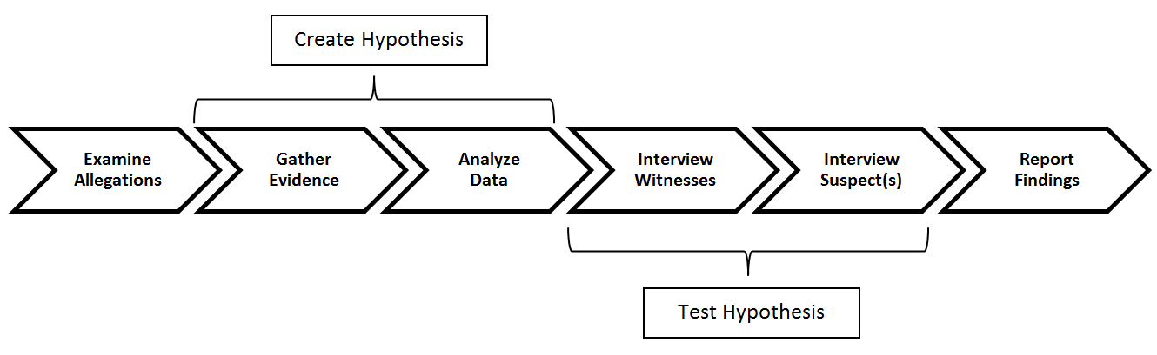
Investigatory Process
Investigator is trying to find proof that allegation did occur or proof that it did not occur.

Slide 16
FBI Forensic Accountant
Desired Education:
Bachelor’s degree in accounting or degree with 24 semester hours in accounting (six out of 24 hours can be in business law)
Applicable Certifications:
Certified Public Accountant (CPA)
Certified Financial Forensics (CFF-AICPA)
Certified Fraud Examiner (CFE)
Certified Internal Auditor (CIA)
Relevant Work Experience:
Forensic accounting
Public accounting-audit
Government accounting
http://www.fbi.gov/news/stories/2012/march/forensic-accountants_030912/forensic-accountants_030912

Slide 17
TX State Auditor’s Office
Special Investigations Unit (SIU) consists of experienced professional investigators including:
Certified Public Accountants
Certified Fraud Examiners
Certified Fraud Specialists
Certified Government Auditing Professionals
Certified Internal Auditors
Certified Forensic Computer Examiners
Certified Forensic Interviewers
Texas Commission on Law Enforcement Master Peace Officers
Investigative researchers
Paralegals
http://sao.fraud.state.tx.us/AboutUs.aspx

Slide 18
Local Cases in the News

Slide 19
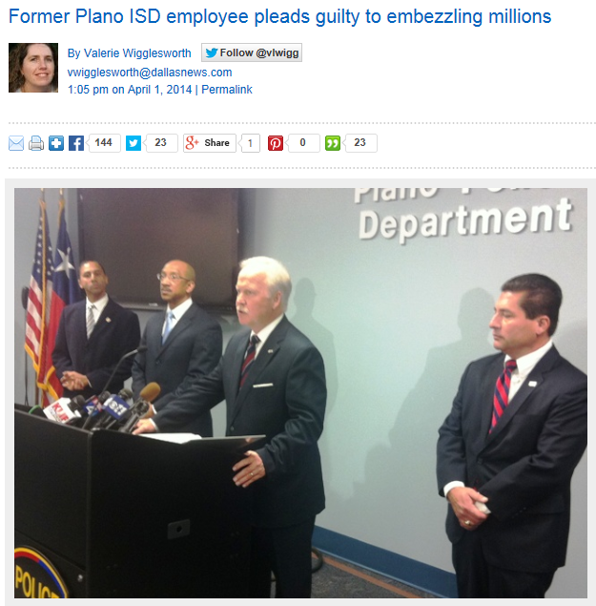

Plano ISD

Slide 20
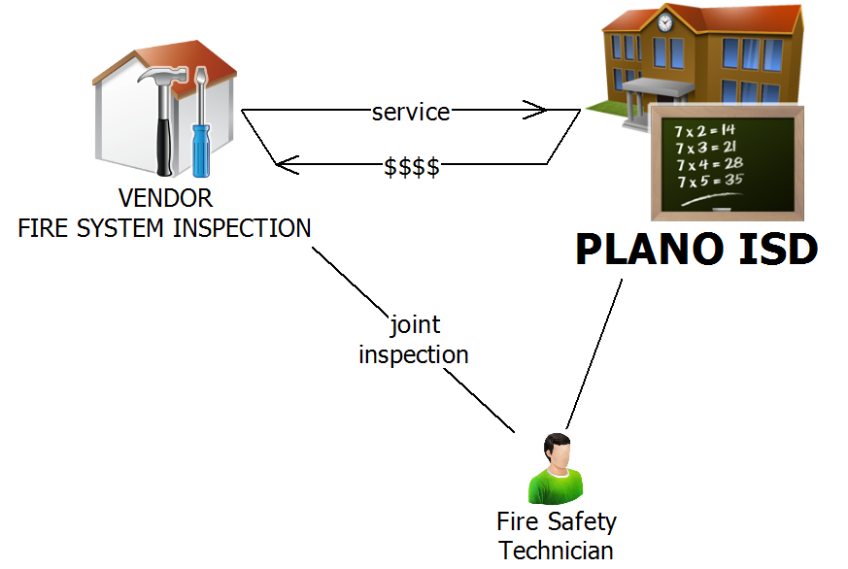
Plano ISD

Slide 21
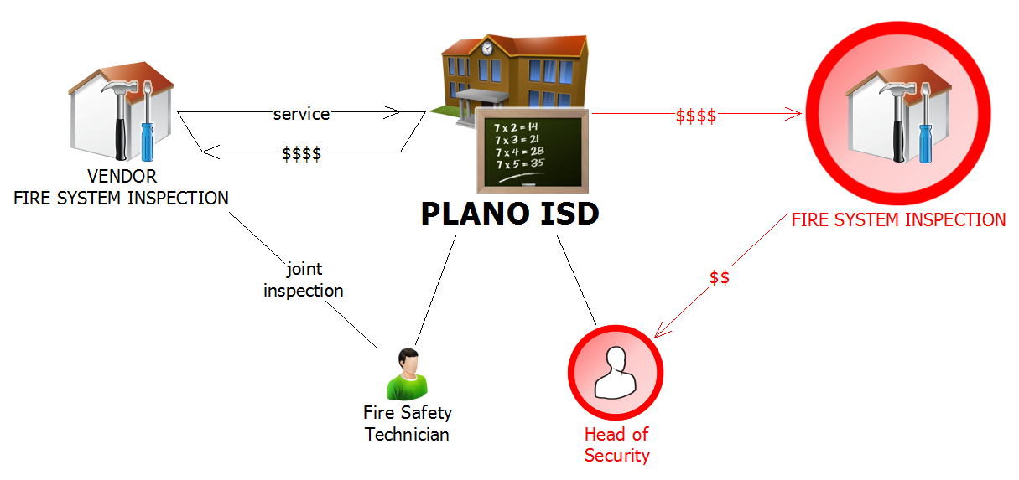
Plano ISD

Slide 22
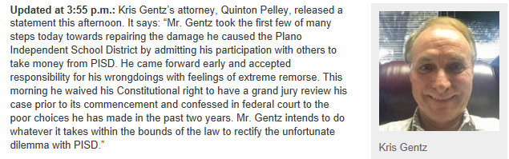
Plano ISD

Slide 23
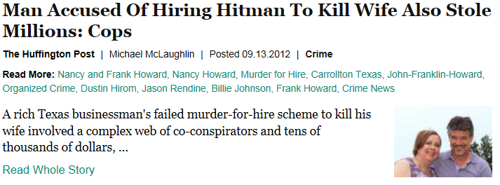
John Howard

Slide 24
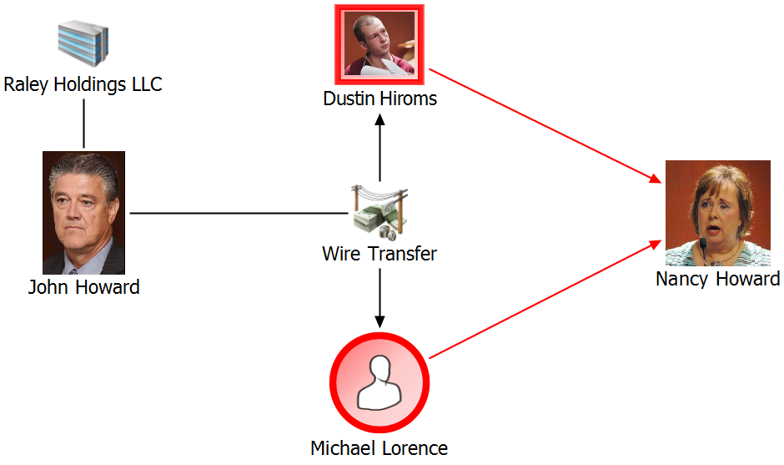
John Howard

Slide 25
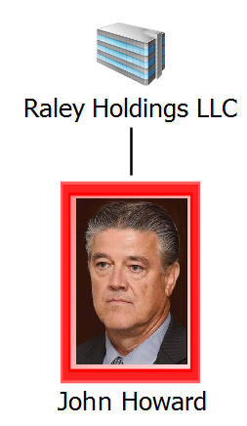
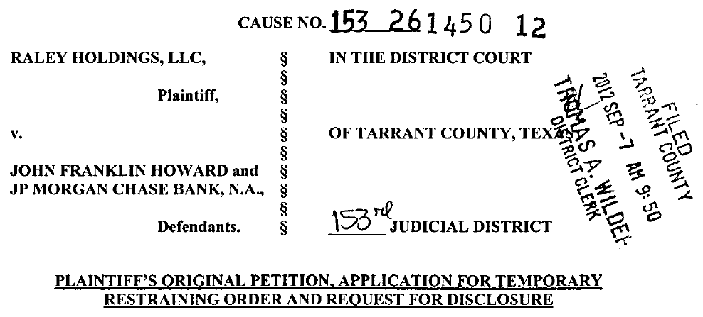
John Howard

Slide 26

Dallas Chapter-ACFE
Student Associate Member
Annual dues for student membership are $10, and do not include ACFE dues.
Student Scholarship Opportunities
The ACFE Dallas Chapter is offering four separate $1,000 scholarships.
  http://www.dallasacfe.org/Student_Center/

Slide 27
Dallas Chapter-ACFE
Student Contact :
Mike Rogers, Director
Email: Miker@plano.gov
  http://www.dallasacfe.org/Student_Center/

Slide 28
Forensic Accountants
Paul Bustos, CFE, CRMA
Manager, Forensic & Litigation Services
Tele: 972-448-9251
E-mail: Paul.Bustos@Weaver.com

